Slide 1
The 6th International Business School Shanghai Conference (2016)
The Reshaping of Business Education
With Technology Development
Kalok Chan
CUHK Business School
The Chinese University of Hong Kong

Slide 2
Development of Business Education
Early 20th century: Vocational/Practical Model
Late 20th century: Academic/Research Model
21st century: Business + Technology Model?

Slide 3






Technology disruption on business

Slide 4
Effect of Technology waves on Business
Real-time data analytics
Artificial intelligence and robotics are replacing repetitive tasks
Smartphones being primary tool for everything
Start-up business

Slide 5
MBA student Preference: Top Employers
1 Google
2 McKinsey & Co.
3 Amazon
4 Bain & Company
5 Apple
6 BCG
7 Deloitte
8 Goldman Sachs
9 J.P. Morgan
10 Nike
11 Walt Disney
12 IDEO
13 Microsoft
14 PwC (PricewaterhouseCoopers)
15 Facebook
**Source: CNN Money (2005)

Slide 6
Demand for MBA students

Slide 7
Effect of Technological waves on Biz Education
E-learning and Online delivery
Less demand for 2-year MBA programs, and more demand for 1-year specialized master programs
Help STEM engineers with management, and help business students know more about STEM

Slide 8
Business Education in the 21st Century
Humanity elements
Blended learning
STEM background
Individualized learning
Team work
Hands-on Experience

Slide 9
A couple of initiatives at CUHK
Entrepreneurship Minor
FinTECH

Slide 10
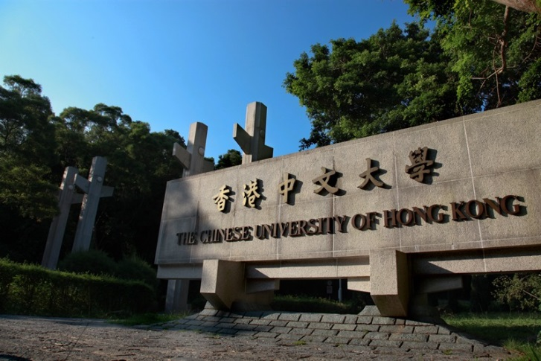
The Chinese University of Hong Kong
Founded in 1963, The Chinese University of Hong Kong (CUHK) is a comprehensive research university with a global vision to combine tradition with modernity, and to bring together the East and the West.
Eight faculties: Arts, Business, Engineering, Education, Law, Medicine, Science, Social Science

Slide 11

The Chinese University of Hong Kong
30,000+ students (50% UG, 50% PG)
International Ranking
  CUHK is ranked 44th in the world and 8th in Asia (QS Rankings 2016)

Slide 12
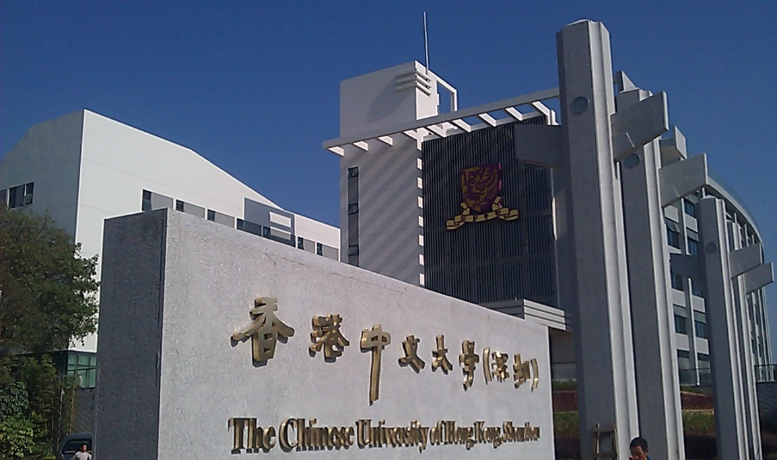
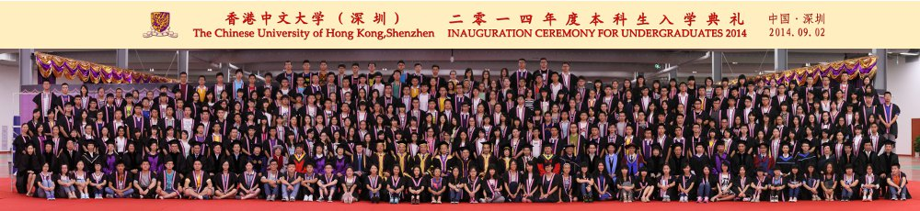
CUHK (Shenzhen)
Establish a campus in Shenzhen with the support of the Shenzhen government
Three Schools:
  School of Economics and Management
  School of Humanities and Social Sciences
  School of Science and Engineering
Shenzhen is the Silicon Valley of China, home to many technology companies (Huawei, Tencent, BYD, ZTE)

Slide 13
Entrepreneurship Minor @ CUHK
University-wide Minor Program
KEY PRINCIPLE:LEARN BY PRACTICE
ENTREPRENEURSHIP IS AN ITERATIVE PROCESS
  If you want to teach people a new way of thinking, don't bother trying to teach them. Instead, give them a tool, the use of which will lead to new ways of thinking.
  ― R. Buckminster Fuller

Slide 14
Entrepreneurship Minor @ CUHK
INTEGRATE MAKING INTO THE CURRICULUM
➤ Involve making/prototyping as early as possible
➤ Accelerate “failure” and encourage pivots
➤ Create maker space for course projects
➤ Provide tools and technical support

Slide 15
Entrepreneurship Minor @ CUHK
- Pre-incubation

Slide 16
Entrepreneurship Minor @ CUHK
- Curriculum Design
  The stages of starting a startup: ideation - realization – commercialization. The curriculum mimics these stages.
  Three key areas:
    Mindset and Values
    Knowledge and Skills
    Practices

Slide 17
Entrepreneurship Minor @ CUHK
- Curriculum design

Slide 18

FinTECH
Innovation in financial services that causes disruption to traditional banking and financial practices
Blockchains, bitcons, peer-to-peer lending, transaction security; data management; risk management; financial data analytics; digital currencies; mobile payments; and crowdfunding.

Slide 19
FinTECH
Collaboration with Industry on Research and Education along five areas:
  Cybersecurity
  Blockchains
  Data Analytic
  Authentication
  Internet Finance
Business School can participate in a couple of areas, but requires the joint participation of engineering school in a few other areas
Coordination between the schools and cooperation among faculty are the keys to success

Slide 20
FinTECH
Hong Kong is trying to catch up in FinTECH
Government and industry are pushing for that
  Regulatory
  Technology
  Economics
  Human talents
CUHK Business School and Engineering School in discussion and collaboration with the industry

Slide 21
Obstacles to Entrepreneurship and Technology Initiatives
Shortage of faculty with practical experience
Technology rests in other schools
Massive coordination (university-wide program)
Value proposition in collaboration with industry

Slide 22
Conclusion
Business schools have to …….
  Embrace technology disruption
  Transform/modify/fine-tune the current business models
  Engineer greater coordination with other Schools
  Justify the legitimacy

